Slide 1
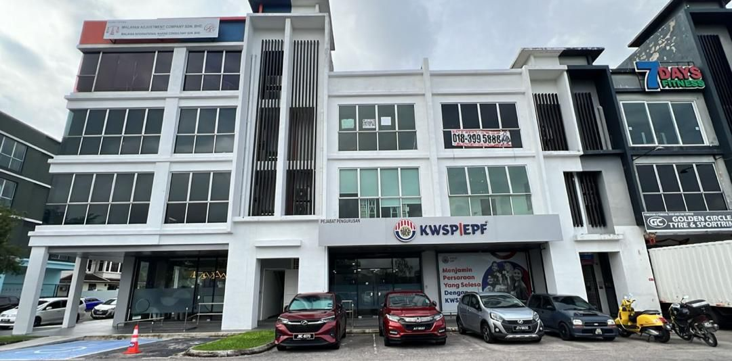
PROPERTY ADDRESS:
NO.40 GROUND – 3RD FLOOR, JALAN PERMAS 15/1,
BANDAR BARU PERMAS JAYA,
81750 MASAI, JOHOR.

Slide 2
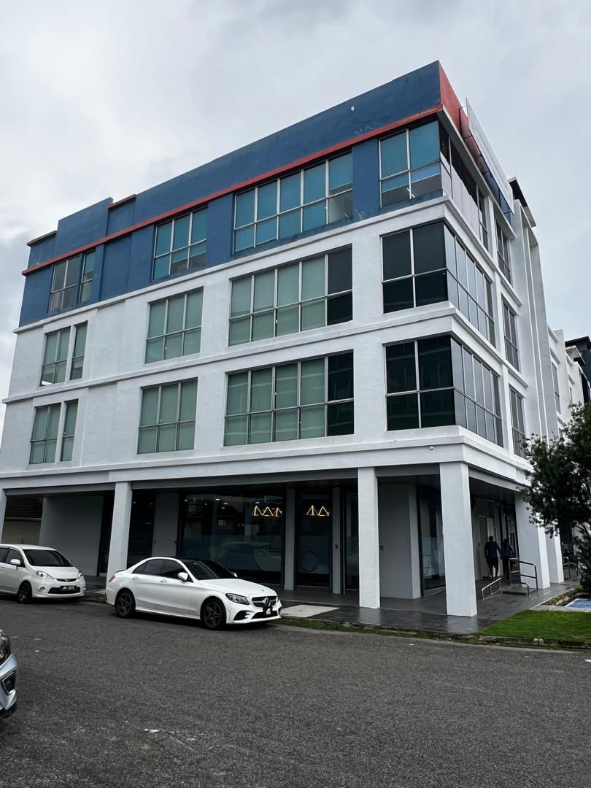
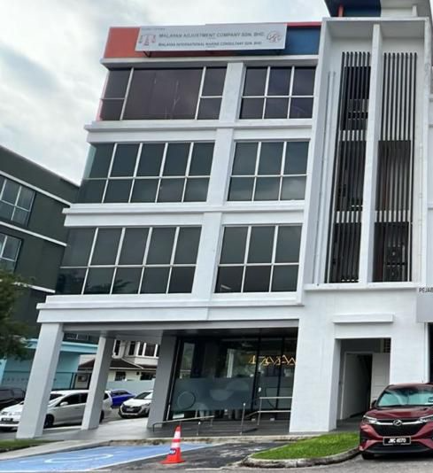
CORNER 4 STOREY SHOPLOT
GROUND FLOOR (ADJOINING RENTAL) – EPF
1ST FLOOR – EPF
2ND FLOOR – EPF
3RD FLOOR – MALAYAN ADJUSTMENT COMPANY S/B

Slide 3
CURRENT RENT:
GROUND, 1ST & 2ND FLOOR (EPF): RM13,500
3RD FLOOR (MALAYAN ADJUSTMENT CO): RM2,600
TOTAL: RM16,100 X 12 = 193,200 ANNUAL RENT
RENEWAL RENT:
GROUND, 1ST & 2ND FLOOR (EPF): RM14,850 (BY 31/3/2026 IN TENANCY AGREEMENT)
3RD FLOOR (MALAYAN ADJUSTMENT CO): RM3,500 (SIGNED RENEWAL FOR 15/10/2025 – 14/10/2026) & RM3,600 (SIGNED RENEWAL FOR 15/11/2025 – 14/10/2027)
TOTAL RENEWAL RENT: RM18,350 X 12 = RM220,200 ANNUAL RENT
SALE ASKING PRICE:
RM5,415,000
FREEHOLD PROPERTY
RENTAL YIELD @ 4% (RM220,200 ANNUAL RENT)
EPF TENANCY AGREEMENT: TOTAL 9 YEARS

Slide 4
